Slide 1


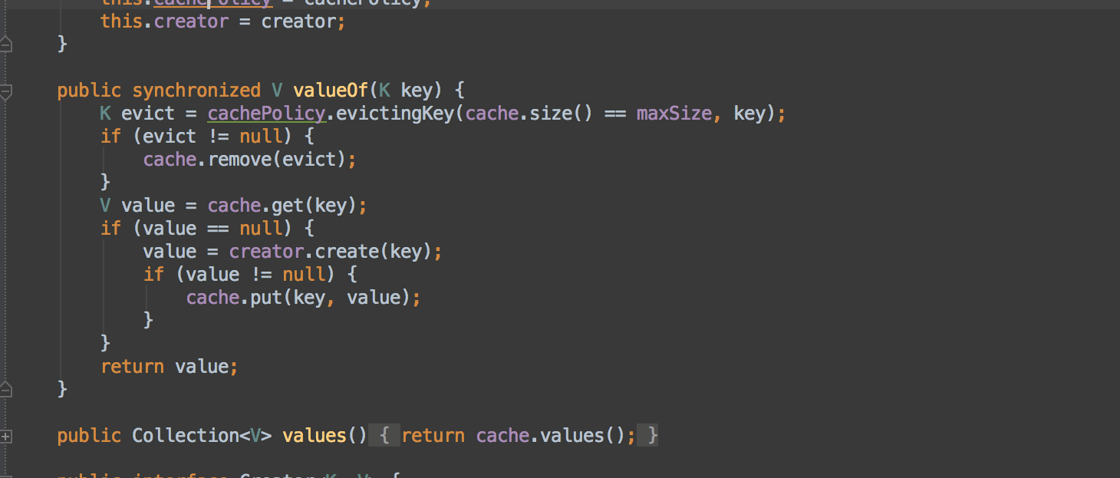


Functional Programming
Lambda Expressions
Advanced
Java
SoftUni Team
Technical Trainers
Software University
http://softuni.bg

Slide 2
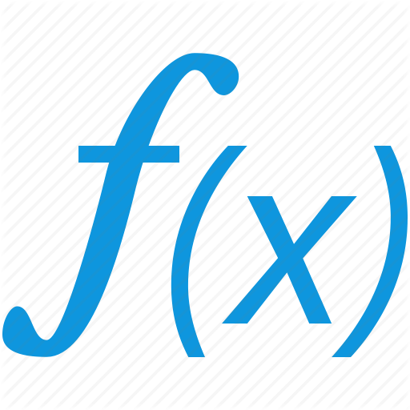

Table of Contents
Lambda Expressions
What is a Function?
Function<T,R>
Other Function Types
Consumer<T>
Supplier<T>
Predicate<T>
BiFunction<T, U, R>
Passing Functions to Methods
λ

Slide 3
Questions
sli.do #JavaAdvanced

Slide 4

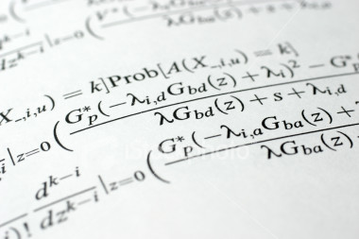
Lambda Expressions

Slide 5
Lambda Expressions
A lambda expression is an unnamed function with parameters and a body
Lambda syntax
Use the lambda operator ->
Read as "goes to"
Parameters can be enclosed in parentheses ()
The body holds the expression or statement and can be enclosed in braces {}
(parameters) -> {body}

Slide 6
Lambda Expressions (2)
Implicit lambda expression
Explicit lambda expression
Zero parameters
More parameters
msg -> System.out.println(msg);
(String msg) -> { System.out.println(msg); }
() -> { System.out.println("hi"); }
(int x, int y) -> { return x + y; }

Slide 7

Problem: Sort Odd Numbers
Read Integers from console
Print odd numbers
Print sorted odd numbers
Use 2 Lambda Expresions
4, 2, 1, 3, 5, 7, 1, 4, 2, 12
4, 2, 4, 2, 12
2, 2, 4, 4, 12

Slide 8
Solution: Sort Odd Numbers
//TODO: Read numbers and parse them to List Of Integers
StringBuilder sb = new StringBuilder();
numbers.removeIf(n -> n % 2 != 0);
for (Integer s : numbers) {
sb.append(s);
sb.append(", ");
}
sb.delete(sb.length() -2, sb.length());
System.out.println(sb);
numbers.sort((a, b) -> a.compareTo(b));
//TODO Print sorted numbers
Check your solution here: https://judge.softuni.bg/Contests/Practice/Index/463#0

Slide 9




Functions
Mathematical and Java Functions
Notes:
Functional programming is a programming paradigm
Uses computations of mathematical functions to build programs
Declarative programming paradigm (not imperative)
Pure-functional languages (no variables and loops): Haskell
Almost-functional: Clojure, Lisp, Scheme, Scala, F#, JavaScript
Imperative with functional support: C#, Python, Ruby, PHP, Java
Non-functional: C, Pascal, the old versions of C#, Java, C++, PHP

Slide 10
What is Function?
Mathematic function
f(x) = x²
x
f(x)
Name
3 | 9
1 | 1
0 | 0
4 | 16
-4 | 16
Input
Output
A function is a special relationship where each input has a single output.

Slide 11
Java Functions
Lambda Expressions
Initialization of function
Input and output type can be different type
Input and output type must be from type which we declare them
Function<Integer, String> func = n -> n.toString();
Input type
Output type
Name
Input parameter
Return expression

Slide 12
Function<T, R>
In Java Function<T,R> is a interface that accepts a parameter of type T and returns type R
We use function with .apply()
int increment(int number) {
return number + 1;
}
Function<Integer, Integer> increment = number -> number + 1;
int a = increment.apply(5);
int b = increment.apply(a);

Slide 13
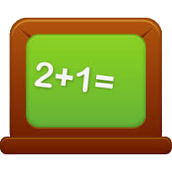

Problem: Sum Numbers
Read numbers from console
Print Count of numbers
Print Sum
Use Function
4, 2, 1, 3, 5, 7, 1, 4, 2, 12
Count = 10
Sum = 41

Slide 14
Solution: Sum Numbers
Scanner scanner = new Scanner(System.in);
String[] input = scanner.nextLine().split(", ");
Function<String, Integer> parser =
x -> Integer.parseInt(x);
int sum = 0;
for (String s : input) {
sum += parser.apply(s);
}
System.out.println("Count = " + input.length);
System.out.println("Sum = " + sum);
Check your solution here: https://judge.softuni.bg/Contests/Practice/Index/463#0

Slide 15


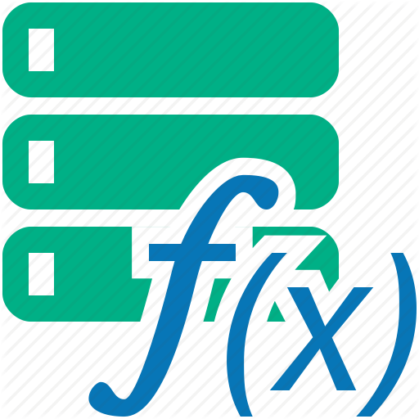
Lambda Expressions
Exercises in class

Slide 16




Other Type Functions
Special Functions
Notes:
Functional programming is a programming paradigm
Uses computations of mathematical functions to build programs
Declarative programming paradigm (not imperative)
Pure-functional languages (no variables and loops): Haskell
Almost-functional: Clojure, Lisp, Scheme, Scala, F#, JavaScript
Imperative with functional support: C#, Python, Ruby, PHP, Java
Non-functional: C, Pascal, the old versions of C#, Java, C++, PHP

Slide 17
Consumer<T>
In Java Consumer<T> is a void interface:
Instead of writing the method we can do:
Then we use it like that:
void print(String message) {
System.out.println(message);
}
Consumer<String> print =
message -> System.out.print(message);
print.accept("pesho");
print.accept(String.valueOf(5));

Slide 18
Supplier<T>
In Java Supplier<T> takes no parameters:
Instead of writing the method we can do:
Then we use it like that:
void genRandomInt()
Random rnd = new Random();
return rnd.nextInt(51);
Supplier<Integer> genRandomInt =
() -> new Random().nextInt(51);
int rnd = generateRandomInt.get();

Slide 19
Consumer and Supplier Example
Supplier<Integer> dice = () -> ThreadLocalRandom.current()
.nextInt(2, 12);
Consumer<String> print = message -> System.out.println(message);
for (int i = 0; i < 4; i++) {
print.accept(dice.get().toString());
}
11
6
5
6
6
8
2
7
2
12
5
3
12
12
10
11
4
6
5
4
8
6
4
2
Possible outputs

Slide 20

Predicate<T>
In Java Predicate<T> evaluates a condition:
Instead of writing the method we can do:
Then we use it like that:
boolean isEven(int number) {
return number % 2 == 0;
}
Predicate<Integer> isEven = number -> number % 2 == 0;
System.out.println(isEven.test(6)); //true

Slide 21
UnaryOperator<T>
UnaryOperator<T> is a function with same type of input/output
Instead of writing the method we can do:
Then we use it like that:
String toUpper(String str) {
return str.toUpperCase()
}
UnaryOperator<String> toUpper = (x)-> x.toUpperCase();
System.out.println(isEven.test(6)); //true

Slide 22

Problem: Count Uppercase Words
Read text from console
Count how many words start with Uppercase
Print count and words
Use Predicate
The following example shows how to use Predicate
2
The
Predicate

Slide 23
Solution: Count Uppercase Words
//TODO: Read text
Predicate<String> checkerUpperCase =
s -> s.charAt(0) == s.toUpperCase().charAt(0);
ArrayList<String> result = new ArrayList<>();
for (int i = 0; i < textAsList.length; i++) {
if (checkerUpperCase.test(textAsList[i])) {
result.add(textAsList[i]);
}
}
//TODO: Print result
Check your solution here: https://judge.softuni.bg/Contests/Practice/Index/463#0

Slide 24


Problem: Add VAT
Read from console some item's prices
Add VAT of 20% to all of them
Use UnaryOperator
Prices with VAT:
1,66
3,07
5,28
1.38, 2.56, 4.4

Slide 25
Solution: Add VAT
//TODO: Read input
List<Double> numbers = new ArrayList<>();
for (String s : input) {
numbers.add(Double.parseDouble(s));
}
UnaryOperator<Double> addVat = x -> x * 1.2;
System.out.println("Prices with VAT:");
for (Double str : numbers) {
System.out.println(String.format("%1$.2f",
addVat.apply(str)));
}
Check your solution here: https://judge.softuni.bg/Contests/Practice/Index/463#0

Slide 26
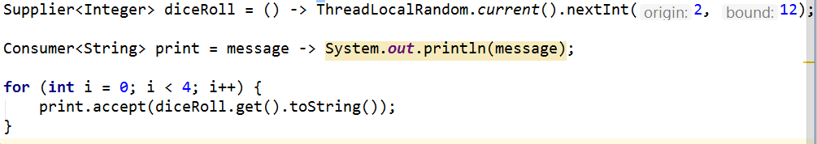
Other Type Functions
Exercises in class

Slide 27
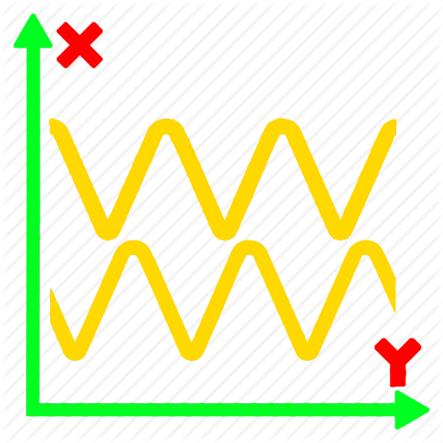
Bi Functions
BiConsumer, BiPredicate, BiFunction
Notes:
Functional programming is a programming paradigm
Uses computations of mathematical functions to build programs
Declarative programming paradigm (not imperative)
Pure-functional languages (no variables and loops): Haskell
Almost-functional: Clojure, Lisp, Scheme, Scala, F#, JavaScript
Imperative with functional support: C#, Python, Ruby, PHP, Java
Non-functional: C, Pascal, the old versions of C#, Java, C++, PHP

Slide 28
BiFunctions
BiFunction <T, U, R>
BiConsumer<T, U>
BiPredicate <T, U>
BiFunction <Integer, Integer, String> sum =
(x, y) -> "The sum of " + x + " and " + y + " is " + (x + y);
BiConsumer<Integer, Integer> sum = (x, y) -> {
System.out.println((x, y) -> "The sum of " + x + " and " + y + " is " + (x + y);
BiPredicate<Integer, Integer> bi = (x, y) -> x == y;
System.out.println(bi.test(2, 3));
//False

Slide 29


Special Functions
IntFunction <R>
IntToDoubleFunction
IntFunction<String> i = (x) -> Integer.toString(x);
IntToDoubleFunction i = (x) -> { return Math.sin(x); };
System.out.println(i.applyAsDouble(2));
// 0.90929742682

Slide 30
Problem: Sum Numbers
Read numbers from console
Print Sum
Print Count of numbers
Use BiFunction
4, 2, 1, 3, 5, 7, 1, 4, 2, 12
Count = 10
Sum = 41

Slide 31
Solution: Sum Numbers
Scanner scanner = new Scanner(System.in);
String[] input = scanner.nextLine().split(", ");
BiFunction<String, String, Integer> parser =
(x, y) -> Integer.parseInt(x) + Integer.parseInt(y);
int sum = 0;
for (int i = 0; i < input.length - 1; i++) {
sum += parser.apply(input[i], input[i + 1]);
}
System.out.println("Count = " + input.length);
System.out.println("Sum = " + sum);
Check your solution here: https://judge.softuni.bg/Contests/Practice/Index/463#0

Slide 32
Passing Functions to Method
We can pass Function<T,R> to methods:
We can use the method like that:
int operation(int number, Function<Integer, Integer> function) {
return function.apply(number);
}
int a = 5;
int b = operation(a, number -> number * 5);
int c = operation(a, number -> number - 3);
int d = operation(b, number -> number % 2);
//b = 25
//c = 2
//d = 1

Slide 33
Problem: Filter by Age
Read from console n people with their age
Read condition and age for filter
Read format type for output
Print all people that fulfills the condition
Pesho | 20
Gosho | 18
Radka | 29
Mara | 32
Izdislav | 16
Condition - "older"
Age - 20
Format - "name age"
Pesho | 20
Radka | 29
Mara | 32

Slide 34
Solution: Filter by Age
//TODO: Read info from console
//Implementation of these methos on next slides
Predicate<Integer> tester = createTester(condition, age);
Consumer<Map.Entry<String, Integer>> printer =
createPrinter(format);
printFilteredStudent(people, tester, printer);
Check your solution here: https://judge.softuni.bg/Contests/Practice/Index/463#0

Slide 35
Solution: Filter by Age (2)
private static Consumer<Map.Entry<String,Integer>> createPrinter(String format)
switch (format)
case "name age":
return person -> System.out.printf("%s - %d%n", person.getKey(), person.getValue());
private static Predicate<Integer> createTester(String condition, Integer age)
switch (condition)
case "younger":
return x -> x <= age;
Add more cases in both methods
Check your solution here: https://judge.softuni.bg/Contests/Practice/Index/463#0

Slide 36
Solution: Filter by Age (3)
public static void printFilteredStudent(
LinkedHashMap<String, Integer> people,
Predicate<Integer> tester,
Consumer<Map.Entry<String, Integer>> printer) {
for (Map.Entry<String, Integer> person :
people.entrySet()) {
if (tester.test(people.get(person.getKey()))) {
printer.accept(person);
}
}
}
Check your solution here: https://judge.softuni.bg/Contests/Practice/Index/463#0

Slide 37
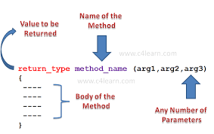
Passing Functions to Method
Exercises in class

Slide 38
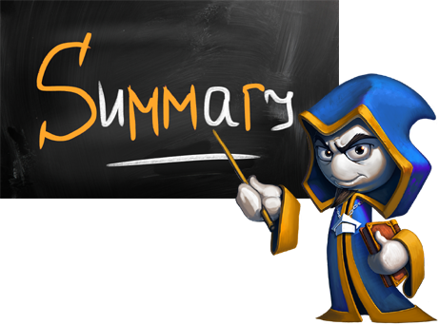
Summary
Lambda expressions are anonymous methods
Consumer<T> is a void function
Supplier<T> gets no parameters
Predicate<T> evaluates a condition
Function<T,R> is a function that returns R type
UnaryOperator<T> is a function that return same type
BiFunction<T, U, R> is a function that accept more parameters
Function can be pass like variable to methods

Slide 39









Java Syntax
https://softuni.bg/courses/java-fundamentals

Slide 40
License
This course (slides, examples, demos, videos, homework, etc.) is licensed under the "Creative Commons Attribution-NonCommercial-ShareAlike 4.0 International" license
Attribution: this work may contain portions from
"Fundamentals of Computer Programming with Java" book by Svetlin Nakov & Co. under CC-BY-SA license

Slide 41






Free Trainings @ Software University
Software University Foundation – softuni.org
Software University – High-Quality Education, Profession and Job for Software Developers
softuni.bg
Software University @ Facebook
facebook.com/SoftwareUniversity
Software University @ YouTube
youtube.com/SoftwareUniversity
Software University Forums – forum.softuni.bg

